Slide 1
EEB R Bootcamp Intro, basic stats, and plotting
Noa Pinter-Wollman
nmpinter@ucla.edu

Slide 2
Welcome!
Goals: Introduce graduate students to the R environment and provide a foundation for skills in scientific programming.
Course webpage with materials: http://michaelalfaro.github.io/eeb201/
Syllabus:
https://docs.google.com/document/d/17qyGIk6CO1dmmKhIePUt6plxqmlwkvyhe6LoNopvjUQ/edit

Slide 3
Who R we?
Graduate students
Kenji Hayashi
Alayna Mead
Rachel Turba
Rachel Potter
Rosa McGuire
Lizzie Blackmore
Dylan Morris
Amandine Gamble (postdoc)
Instructors
Noa Pinter-Wollman
Mike Alfaro
Kirk Lohmueller
Jamie Lloyd-Smith

Slide 4
Learning objectives
By the end of the course students will:
Be comfortable executing basic commands in the R environment.
Be able to load packages in R and make use of their added functionality.
Be able to read in data files, manipulate data, and perform simple analyses in R.
Be capable of plotting curves, scatter-plots, histograms, and other graphic outputs in R.
Be able to write their own computer programs to simulate population models in discrete or continuous time.

Slide 5
What is R?
“R is a free software environment for statistical computing and graphics.”
A free, open-source, community-built software package.
Powerful, flexible computational tool with a broad array of add-on ‘packages’ that perform advanced analyses.
A high-level programming language for scientific computing.
A powerful platform for statistics.
A major research tool in ecology and other fields.

Slide 6
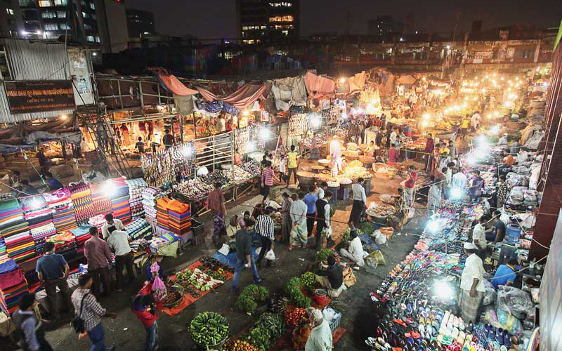
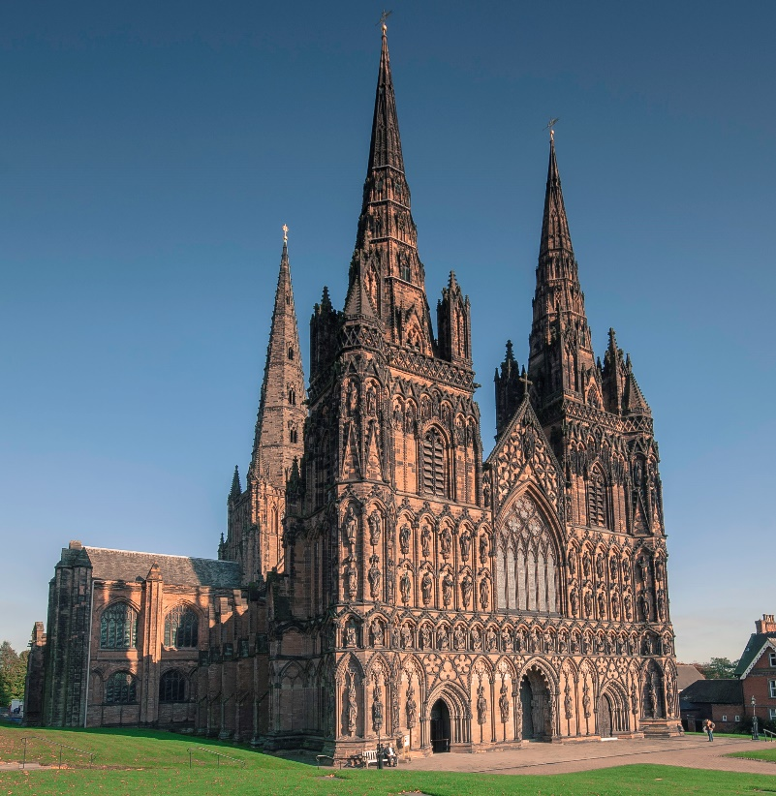
What is R not?
A commercial package
A drop-down menu environment
Excel
JMP, SPSS, SAS, etc.
Matlab

Slide 7

Why R?
Free
Widely used in ecology and evolution
Helpful, active, and large user community
Lots of resources (formal packages and informal community)
Versatile
Flexible
Data manipulation capabilities
Reproducible
Scalable
Transferable programming skills

Slide 8
R Bootcamp schedule
Tuesday September 14th
9-10:30 intro to the bootcamp and Basic stats and plotting – Pinter-Wollman
10:30-12 Flow control, scripts, functions –Alfaro
12-1:00 Lunch
1:00-3:00PM Work on assignments
Friday September 17th
9-10:30 Advanced plotting - Lohmueller
10:30-12 Working with data and population dynamics - Lloyd Smith
12:30-1:00 Lunch
1:00-3:00PM Work on assignments

Slide 9
What will you be learning?
Command line, scripts, and functions
Getting help in R
Packages/libraries
Reading data
Variables
Subsetting and indexing specific data
Control flow (for, if, while…)
Functions
Plotting
Basic modelling

Slide 10



R resources
https://cran.r-project.org/
R studio (https://www.rstudio.com/)
R for biologists (https://cran.r-project.org/doc/contrib/Martinez-RforBiologistv1.1.pdf)
Springer series ‘Use R!’ is available free through UCLA library
R for Data Science http://r4ds.had.co.nz/
Quick R: http://www.statmethods.net/
R reference card: ftp://cran.r-project.org/pub/R/doc/contrib/Short-refcard.pdf
R colors: http://research.stowers-institute.org/efg/R/Color/Chart/ColorChart.pdf
Other grad students (Hacky hour)
Stats consulting on campus
Collaboratory and IDRE workshops
Google!

Slide 11
What is the plan for the next 1.5 hours?
Running statistical tests
Plotting

Slide 12
Basic statistics
T-tests
ANOVA
Correlation
Other linear models
More advances statistics – EEB202C

Slide 13
Some advice about script layout
Setup (e.g., clean workspace, load packages)
# set up
rm(list=ls()) # clean workspace
graphics.off() #close all figures
#load packages
library(‘igraph’)
2. Load data and prepare it for analysis (e.g., subset, assign data type…)
3. Perform analysis
4. Display results (plot, save output etc…)

Slide 14

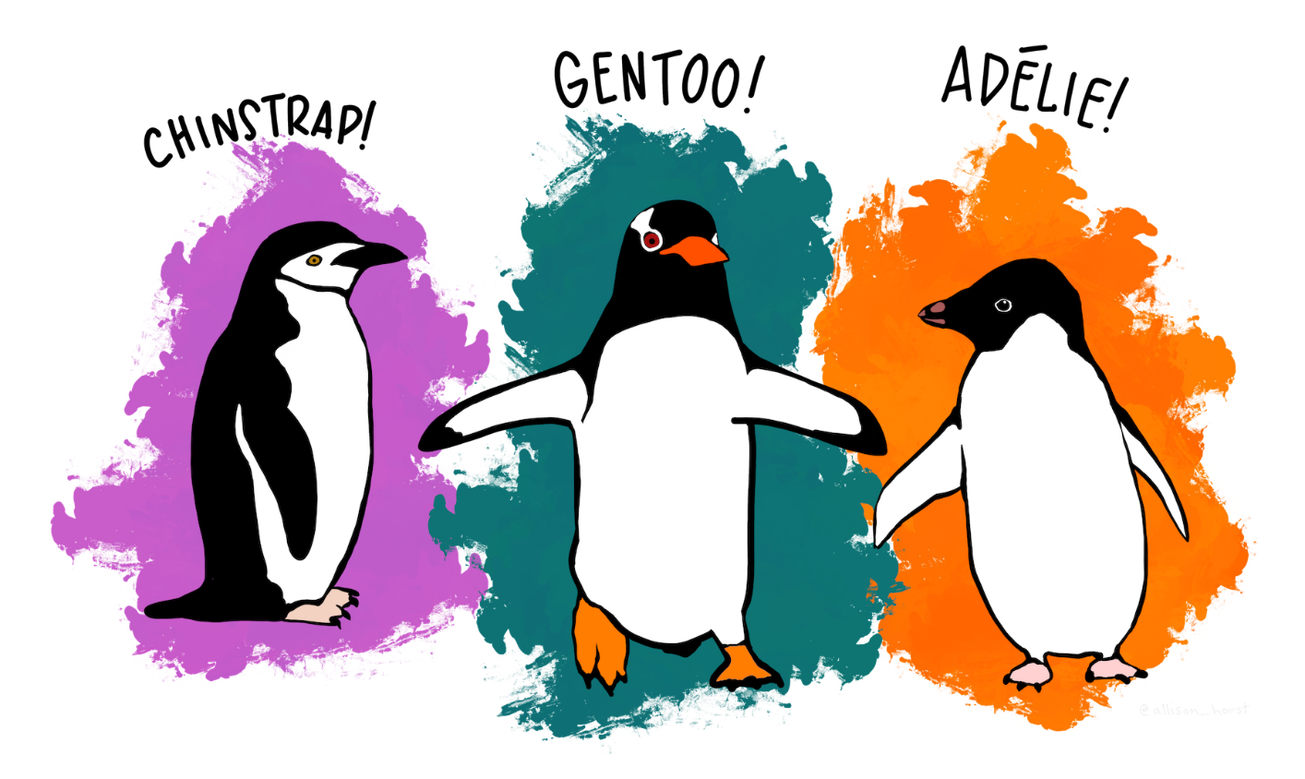
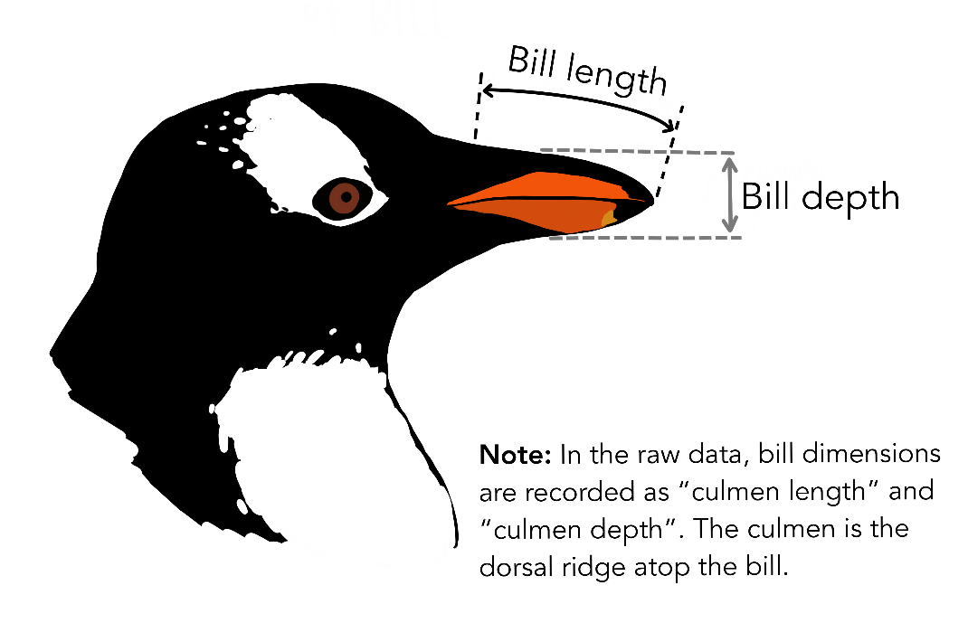
Dataset to work on today
library(palmerpenguins)
There are two data sets in the package, we will use ‘penguins’ which is the simplified data frame of the raw data (which is also available for those into penguins…)
Flipper length and Body mass

Slide 15
Advanced plotting
Color palettes
Heatmaps
The R graph gallery:
http://www.r-graph-gallery.com/all-graphs/
ggplot2

